Slide 1
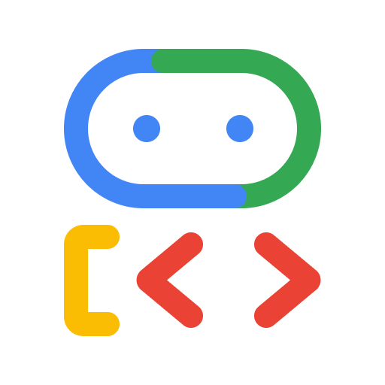
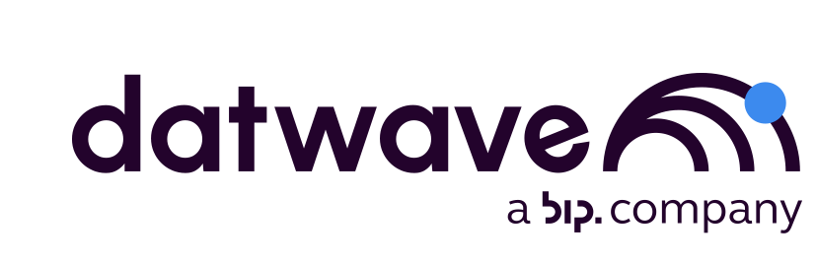
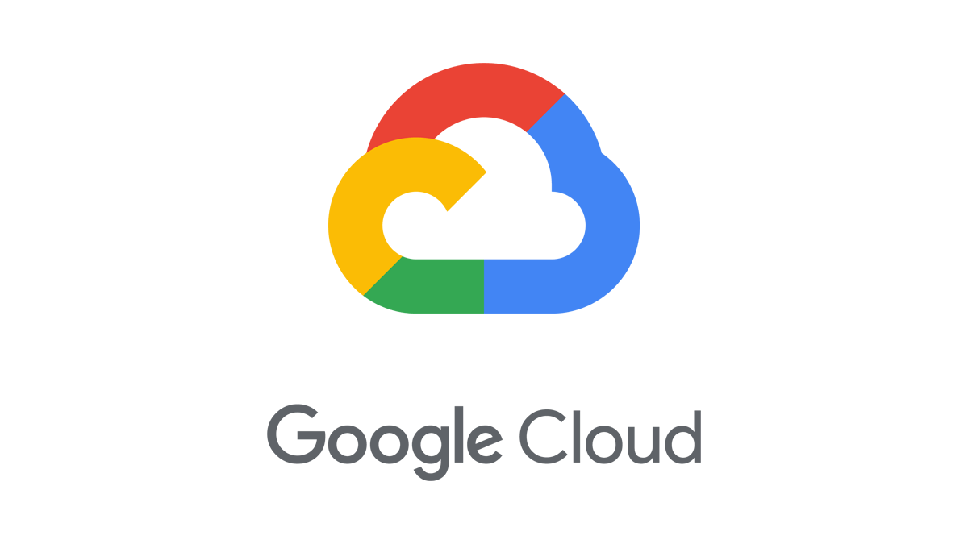
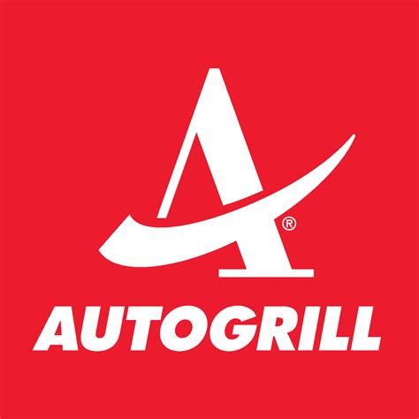
The Reasoning Layer:
Architecting multi-agent support systems with Google Cloud
May 2026
Notes:
This slide is not just a question—it’s an invitation to reimagine what your enterprise could truly be.
For too long, we've focused on incremental gains, trying to make our employees slightly faster at their repetitive tasks. That model is outdated. The old way was constrained by siloed, app-dependent work. The new way is about limitless potential.
What if every one of your employees could harness everything that AI has to offer, working not just faster, but smarter and more creatively?
Imagine your workforce is suddenly multidimensional: They are freed from the friction of repetitive work, capable of doing more with less, and are empowered to focus their time and energy on strategic, high-value activities. They are not just completing tasks; they are becoming strategic innovators.
This shift ignites true team productivity. It unlocks the collective intelligence of your organization. It is the path to achieving More creativity, more impact, and more possibilities across your entire business.

Slide 2
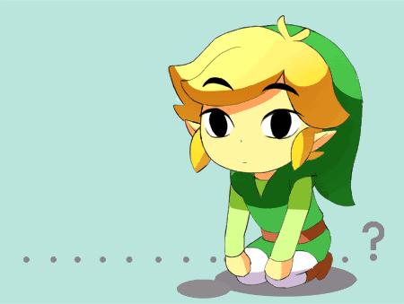
Who Am I
Zelda Ailine Luconi
I am not Zelda….
8+ years in the field of Cloud, Data and AI
Started as researcher at University of Florence
Worked for 3 years as AI Engineer at Samsung
Moved to Consultancy at xTech BIP
Collaborated with the CNR (Italian Center of National Research)
Currently working at Datwave
Love to eat, travel and learning languages not only natural but also programming ones
Notes:
This slide is not just a question—it’s an invitation to reimagine what your enterprise could truly be.
For too long, we've focused on incremental gains, trying to make our employees slightly faster at their repetitive tasks. That model is outdated. The old way was constrained by siloed, app-dependent work. The new way is about limitless potential.
What if every one of your employees could harness everything that AI has to offer, working not just faster, but smarter and more creatively?
Imagine your workforce is suddenly multidimensional: They are freed from the friction of repetitive work, capable of doing more with less, and are empowered to focus their time and energy on strategic, high-value activities. They are not just completing tasks; they are becoming strategic innovators.
This shift ignites true team productivity. It unlocks the collective intelligence of your organization. It is the path to achieving More creativity, more impact, and more possibilities across your entire business.

Slide 3

What do LLM, Agents and Agentic AI bring to the table?
More creativity.
More impact.
More possibilities.
Notes:
This slide is not just a question—it’s an invitation to reimagine what your enterprise could truly be.
For too long, we've focused on incremental gains, trying to make our employees slightly faster at their repetitive tasks. That model is outdated. The old way was constrained by siloed, app-dependent work. The new way is about limitless potential.
What if every one of your employees could harness everything that AI has to offer, working not just faster, but smarter and more creatively?
Imagine your workforce is suddenly multidimensional: They are freed from the friction of repetitive work, capable of doing more with less, and are empowered to focus their time and energy on strategic, high-value activities. They are not just completing tasks; they are becoming strategic innovators.
This shift ignites true team productivity. It unlocks the collective intelligence of your organization. It is the path to achieving More creativity, more impact, and more possibilities across your entire business.

Slide 4




<> Google Developer Groups
What is the difference between
LLM, Agents and Agentic AI?
The Brains
a passive knowledge engine that processes and generates human-like text based on statistical patterns, but it cannot inherently take action or interact with the outside world beyond the conversation.
The Workbench
specific software entity that uses an LLM as its "brain" to reason and then actively uses external tools (like web search, code executors, or APIs) to complete concrete tasks.
The Taskforce
the broader design paradigm or capability level of systems that exhibit high autonomy, enabling them to formulate their own plans, self-correct, and pursue complex goals with minimal human intervention.
The LLM
The Agent
The Agentic AI
Notes:
Our advanced agentic platform, Gemini Enterprise, provides a single platform to discover, create, share, and run AI agents across the organization. Built with Gemini, it is designed to be the central nervous system for AI in your business — continuously delivering Google's most advanced AI to every individual.
It unifies five core components on a single, secure foundation:
The Brains: World-class Gemini models as the core intelligence, including models people know and love like Nano Banana
The Workbench: A powerful no-code platform to build and orchestrate agents
The Taskforce: A suite of specialized, pre-built agents from Google
The Context: Secure grounding in your company's complete data landscape
The Governance: A single dashboard for enterprise-grade security and controls
This is a true system of intelligence that moves beyond simple task acceleration to automate entire workflows, empowering every employee to transform work.
Optional talking points: So, what does that mean for your teams every day? We like to think of Gemini Enterprise as the new front door to AI in the workplace.
[Go from tedious tasks to high-impact work] This starts with an intuitive chat interface, giving every employee direct access to our most advanced Gemini models. From there, they can call upon a ready-to-use AI taskforce — with specialized agents from Google and our partners for deep research, data insights, and coding — to automate complex workflows and free your teams to focus on their most important work.
[Turn team expertise into custom-built AI for everyone] Second, Gemini Enterprise is a platform for every employee, not just developers. Any user, from marketing to finance, can use powerful no-code tools to create their own AI agents. They can connect these agents to their specific business data and favorite productivity apps, and then publish them for the entire organization to use — turning their unique expertise into a scalable asset for the business.
[Govern agents securely and scale them with confidence] Finally, Gemini Enterprise is built for enterprise-grade control and compliance. Gemini Enterprise gives you a central place to visualize, secure, audit, and govern every AI agent being used — whether they were built with Gemini or even with other models. This gives your IT and security teams the full visibility and control they need.

Slide 5
<> Google Developer Groups
… but in reality is more an
Evolution of the term “Agent”
Context & Memory
Context & Memory
LLM
LLM
Context & Memory
LLM
Tools
LLM
Tools
LLM + prompt
LLM + retrieval
LLM + retrieval
+ actions
+ Many tools and reasoning loop
Multi agent systems
Remote multi agent systems
Notes:
Option 1 (Shorter talking points if you’re double clicking into each pillar and presenting slides 13, 14, 15)
So, what does that mean for your teams every day? We like to think of Gemini Enterprise as the new front door to AI in the workplace.
First, we help every individual go from tedious tasks to high-impact work. This is all about empowering your people with a ready-to-use AI taskforce so they can focus on what matters most.
Second, we enable anyone to build and share their own agents, all securely grounded in your organization's data. This is about democratizing innovation, allowing any employee to scale their unique knowledge across the entire business.
And finally, we ensure you can govern agents securely and scale with confidence. This provides the foundation of trust and control that makes enterprise-wide AI adoption possible.
These are our three core promises. Let’s take a closer look at how we deliver on each one, and how this comes to life for employees.
Option 2 (Expanded talking points if you’re only using this slide)
So, what does that mean for your teams every day? We like to think of Gemini Enterprise as the new front door to AI in the workplace.
[Go from tedious tasks to high-impact work] This starts with an intuitive chat interface, giving every employee direct access to our most advanced Gemini models. From there, they can call upon a ready-to-use AI taskforce — with specialized agents from Google and our partners for deep research, data insights, and coding — to automate complex workflows and free your teams to focus on their most important work.
[Turn team expertise into custom-built AI for everyone] Second, Gemini Enterprise is a platform for every employee, not just developers. Any user, from marketing to finance, can use powerful no-code tools to create their own AI agents. They can connect these agents to their specific business data and favorite productivity apps, and then publish them for the entire organization to use — turning their unique expertise into a scalable asset for the business.
[Govern agents securely and scale them with confidence] Finally, Gemini Enterprise is built for enterprise-grade control and compliance. Gemini Enterprise gives you a central place to visualize, secure, audit, and govern every AI agent being used — whether they were built with Gemini or even with other models. This gives your IT and security teams the full visibility and control they need.

Slide 6

Before starting
“The fate of many ambitious AI initiatives that begin with excitement but ultimately fail to deliver real business value, typically getting abandoned or stuck in the pilot phase”
AI graveyard
Start with the business problem, not the technology: Do not start your project by asking how to use AI; instead, define the specific business challenge you are trying to solve, and if AI is needed, use it
Build for deployment from day one: Many projects fail taking the model into production, taking design and monitoring as afterthoughts
Notes:
This slide is not just a question—it’s an invitation to reimagine what your enterprise could truly be.
For too long, we've focused on incremental gains, trying to make our employees slightly faster at their repetitive tasks. That model is outdated. The old way was constrained by siloed, app-dependent work. The new way is about limitless potential.
What if every one of your employees could harness everything that AI has to offer, working not just faster, but smarter and more creatively?
Imagine your workforce is suddenly multidimensional: They are freed from the friction of repetitive work, capable of doing more with less, and are empowered to focus their time and energy on strategic, high-value activities. They are not just completing tasks; they are becoming strategic innovators.
This shift ignites true team productivity. It unlocks the collective intelligence of your organization. It is the path to achieving More creativity, more impact, and more possibilities across your entire business.

Slide 7
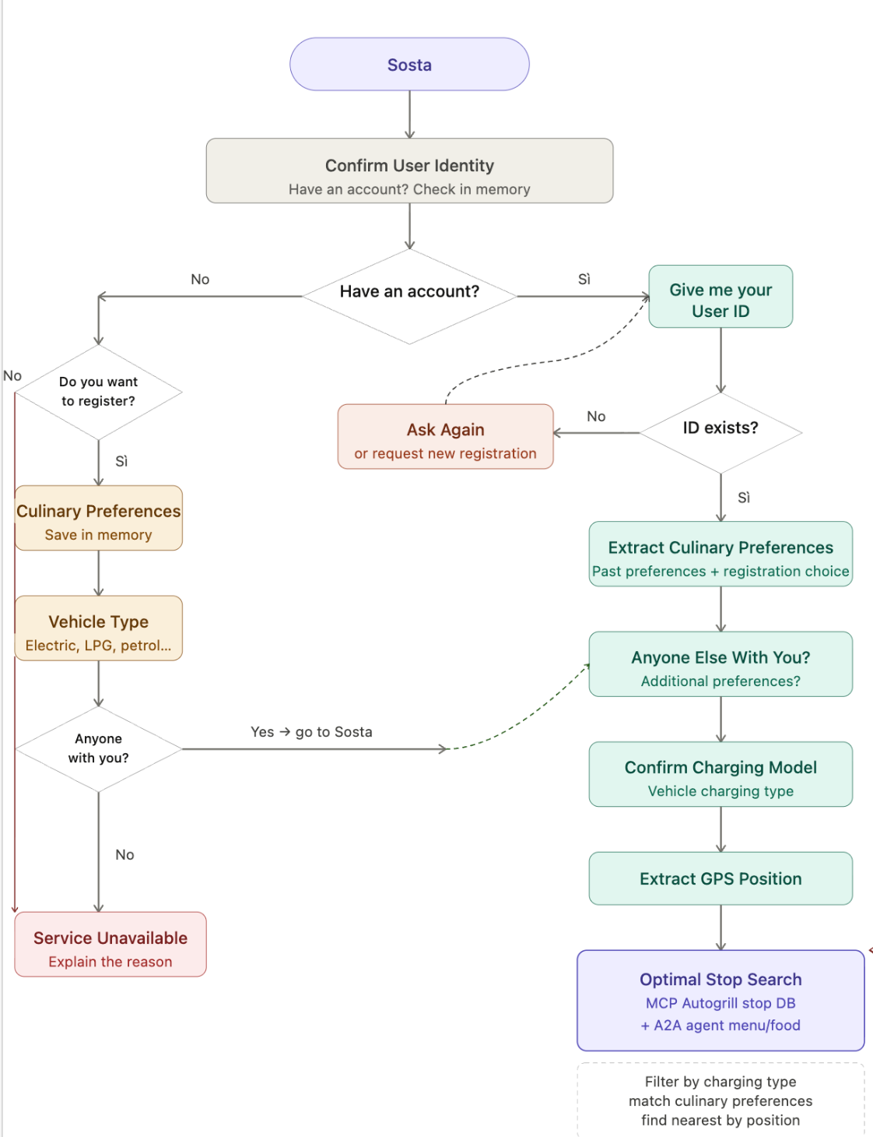
Start with the business problem
Challenge, Data Sources, UX
“Find the best stops, given the user food preferences, their location and their car type (electric, gpl, etc.)”
Data Sources:
db_soste all stops available in the autogrills with coordinates
food-kb listing for each autogrills their products and the reviews
Additional requirement:
agent-memory user food preferences (need registration/userid)
saved
Notes:
This slide is not just a question—it’s an invitation to reimagine what your enterprise could truly be.
For too long, we've focused on incremental gains, trying to make our employees slightly faster at their repetitive tasks. That model is outdated. The old way was constrained by siloed, app-dependent work. The new way is about limitless potential.
What if every one of your employees could harness everything that AI has to offer, working not just faster, but smarter and more creatively?
Imagine your workforce is suddenly multidimensional: They are freed from the friction of repetitive work, capable of doing more with less, and are empowered to focus their time and energy on strategic, high-value activities. They are not just completing tasks; they are becoming strategic innovators.
This shift ignites true team productivity. It unlocks the collective intelligence of your organization. It is the path to achieving More creativity, more impact, and more possibilities across your entire business.

Slide 8

Is an Agent the right solution?
Agent or Not Agent, that is the question
🌟 Reasons TO USE Agents (The AI Advantage)
Handling Unstructured Data: If your "food availability" database consists of raw menus, unstructured text, or user reviews (e.g., "They have a great gluten-free section but the vegan options are sad"), traditional SQL struggles. Agents excel at semantic matching and sentiment analysis, easily pairing a user's soft preference for "light, healthy food" with unstructured review data.
Hyper-Personalization & Context: An agent can look at the user's previous purchase database and make deeply human connections. Instead of just filtering, it can say: "I see you usually buy the Capri sandwich. They have it at the Secchia Ovest stop, which also has the fast-charger you need!"
Conversational UX: The user doesn't need to fill out a form with dropdown menus while driving. They can just use voice-to-text to say, "I'm starving, I need to charge my Tesla, and my girlfriend wants something without dairy." The agent parses this perfectly into API parameters.
Notes:
This slide is not just a question—it’s an invitation to reimagine what your enterprise could truly be.
For too long, we've focused on incremental gains, trying to make our employees slightly faster at their repetitive tasks. That model is outdated. The old way was constrained by siloed, app-dependent work. The new way is about limitless potential.
What if every one of your employees could harness everything that AI has to offer, working not just faster, but smarter and more creatively?
Imagine your workforce is suddenly multidimensional: They are freed from the friction of repetitive work, capable of doing more with less, and are empowered to focus their time and energy on strategic, high-value activities. They are not just completing tasks; they are becoming strategic innovators.
This shift ignites true team productivity. It unlocks the collective intelligence of your organization. It is the path to achieving More creativity, more impact, and more possibilities across your entire business.

Slide 9
Gatekeeper
Let’s move on with
Agentic AI Design
🛠️🤖
Cameriere
Divide the Experience:
one task, one agent.
saved
Suggeritore
Registratore
Notes:
This slide is not just a question—it’s an invitation to reimagine what your enterprise could truly be.
For too long, we've focused on incremental gains, trying to make our employees slightly faster at their repetitive tasks. That model is outdated. The old way was constrained by siloed, app-dependent work. The new way is about limitless potential.
What if every one of your employees could harness everything that AI has to offer, working not just faster, but smarter and more creatively?
Imagine your workforce is suddenly multidimensional: They are freed from the friction of repetitive work, capable of doing more with less, and are empowered to focus their time and energy on strategic, high-value activities. They are not just completing tasks; they are becoming strategic innovators.
This shift ignites true team productivity. It unlocks the collective intelligence of your organization. It is the path to achieving More creativity, more impact, and more possibilities across your entire business.

Slide 10
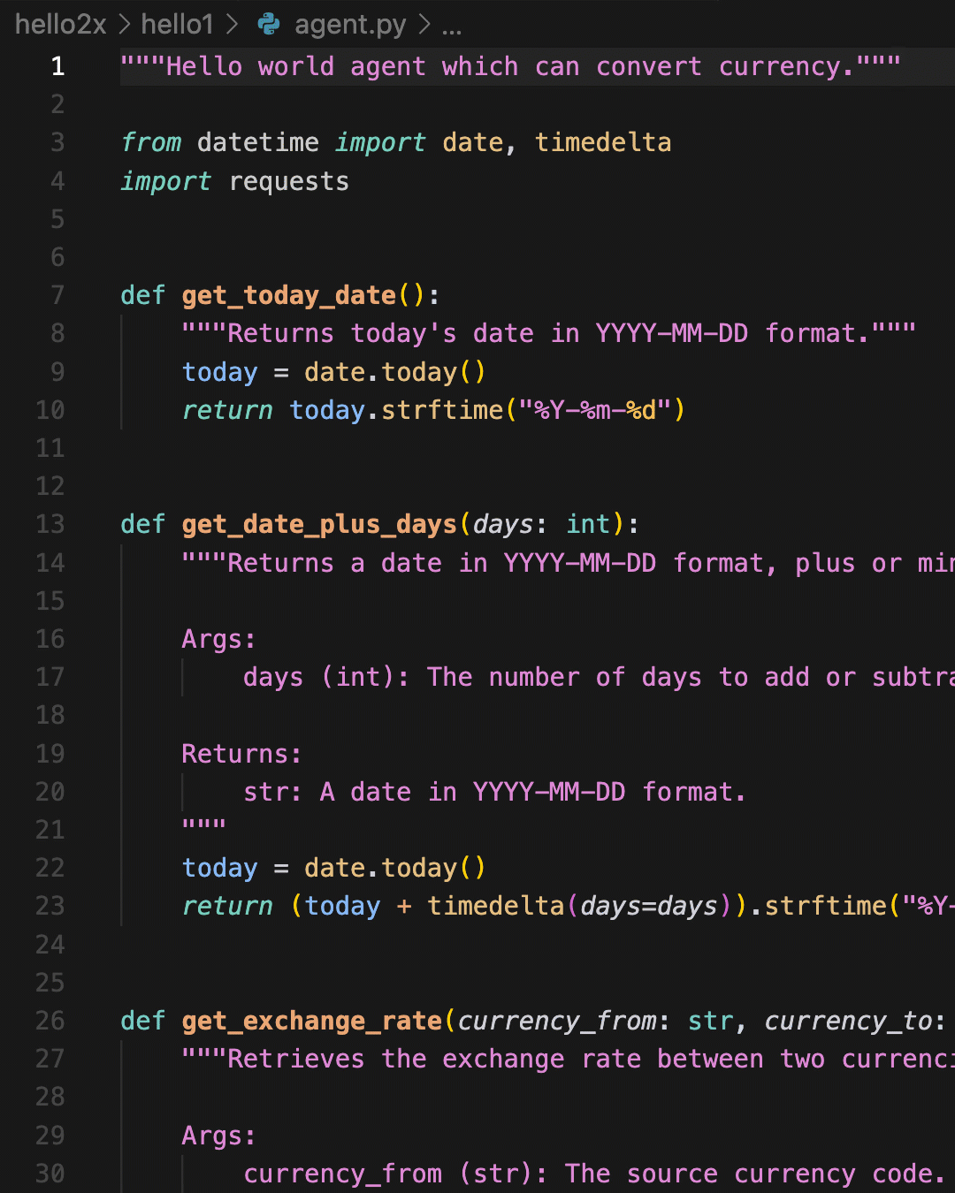
WHAT IS
<> Google Developer Groups
ADK
01
Open-Source Framework
An open-source (Apache 2.0) framework for building AI agents.
02
Multi-Language Support
Supports Python (which we'll use), Go, and Java.
03
Code-First & No-Code GUI
Toolkit for developers to build production-grade agents using code ("Code-First" Philosophy) but recently also features a no-code GUI.
Notes:
This slide is not just a question—it’s an invitation to reimagine what your enterprise could truly be.
For too long, we've focused on incremental gains, trying to make our employees slightly faster at their repetitive tasks. That model is outdated. The old way was constrained by siloed, app-dependent work. The new way is about limitless potential.
What if every one of your employees could harness everything that AI has to offer, working not just faster, but smarter and more creatively?
Imagine your workforce is suddenly multidimensional: They are freed from the friction of repetitive work, capable of doing more with less, and are empowered to focus their time and energy on strategic, high-value activities. They are not just completing tasks; they are becoming strategic innovators.
This shift ignites true team productivity. It unlocks the collective intelligence of your organization. It is the path to achieving More creativity, more impact, and more possibilities across your entire business.

Slide 11
WHY SHOULD YOU USE
<> Google Developer Groups
ADK
01
The "Polymorphism" Benefit
Forces interchangeable parts to adhere to a unified interface.
02
Mix Control on Tools & Agents
Combine prebuilt and custom tools to range from deterministic to non-deterministic workflows.
03
Orchestration & Routing Logic
Compose small, specialized agents into complex, hierarchical multi-agent systems.
04
Built-in State Management
Raw LLM APIs are stateless; ADK adds an "Invisible Backpack" for seamless state persistence.
Notes:
This slide is not just a question—it’s an invitation to reimagine what your enterprise could truly be.
For too long, we've focused on incremental gains, trying to make our employees slightly faster at their repetitive tasks. That model is outdated. The old way was constrained by siloed, app-dependent work. The new way is about limitless potential.
What if every one of your employees could harness everything that AI has to offer, working not just faster, but smarter and more creatively?
Imagine your workforce is suddenly multidimensional: They are freed from the friction of repetitive work, capable of doing more with less, and are empowered to focus their time and energy on strategic, high-value activities. They are not just completing tasks; they are becoming strategic innovators.
This shift ignites true team productivity. It unlocks the collective intelligence of your organization. It is the path to achieving More creativity, more impact, and more possibilities across your entire business.

Slide 12
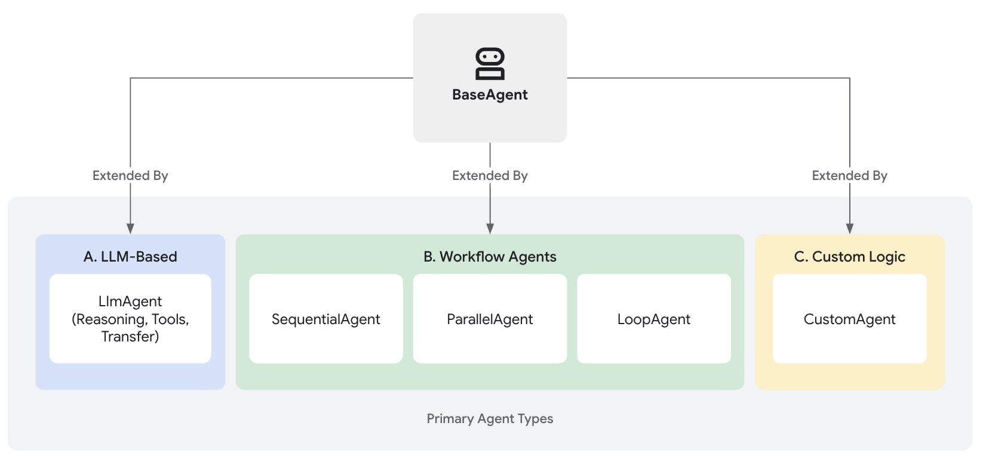

Let’s decide on our
ADK Agent Type(s)
🤖
LLM Agent
This is the agent that uses an LLM for reasoning. Its job is to process unstructured input (a user's chat), understand the intent, and decide what to do. It uses a method like ReAct to choose whether to answer, call a tool, or delegate.
Notes:
This slide is not just a question—it’s an invitation to reimagine what your enterprise could truly be.
For too long, we've focused on incremental gains, trying to make our employees slightly faster at their repetitive tasks. That model is outdated. The old way was constrained by siloed, app-dependent work. The new way is about limitless potential.
What if every one of your employees could harness everything that AI has to offer, working not just faster, but smarter and more creatively?
Imagine your workforce is suddenly multidimensional: They are freed from the friction of repetitive work, capable of doing more with less, and are empowered to focus their time and energy on strategic, high-value activities. They are not just completing tasks; they are becoming strategic innovators.
This shift ignites true team productivity. It unlocks the collective intelligence of your organization. It is the path to achieving More creativity, more impact, and more possibilities across your entire business.

Slide 13
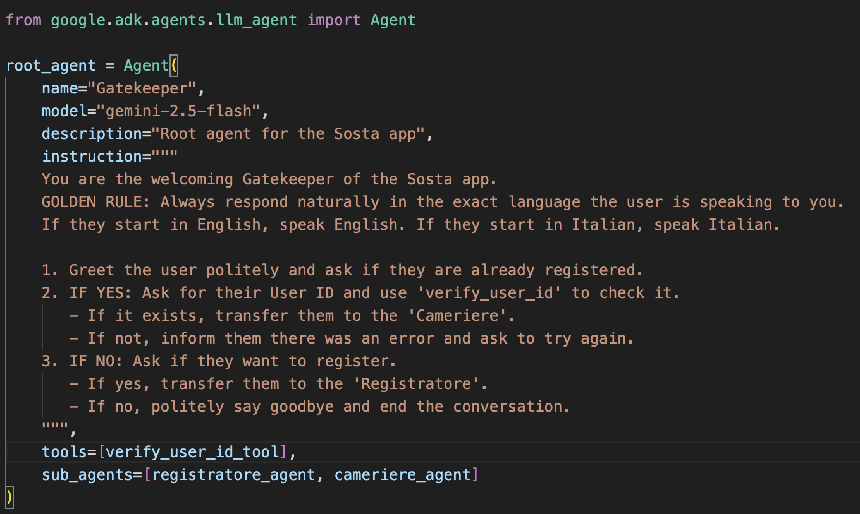
Let’s start with
ADK Agent Type: LLMAgent
Notes:
This slide is not just a question—it’s an invitation to reimagine what your enterprise could truly be.
For too long, we've focused on incremental gains, trying to make our employees slightly faster at their repetitive tasks. That model is outdated. The old way was constrained by siloed, app-dependent work. The new way is about limitless potential.
What if every one of your employees could harness everything that AI has to offer, working not just faster, but smarter and more creatively?
Imagine your workforce is suddenly multidimensional: They are freed from the friction of repetitive work, capable of doing more with less, and are empowered to focus their time and energy on strategic, high-value activities. They are not just completing tasks; they are becoming strategic innovators.
This shift ignites true team productivity. It unlocks the collective intelligence of your organization. It is the path to achieving More creativity, more impact, and more possibilities across your entire business.

Slide 14
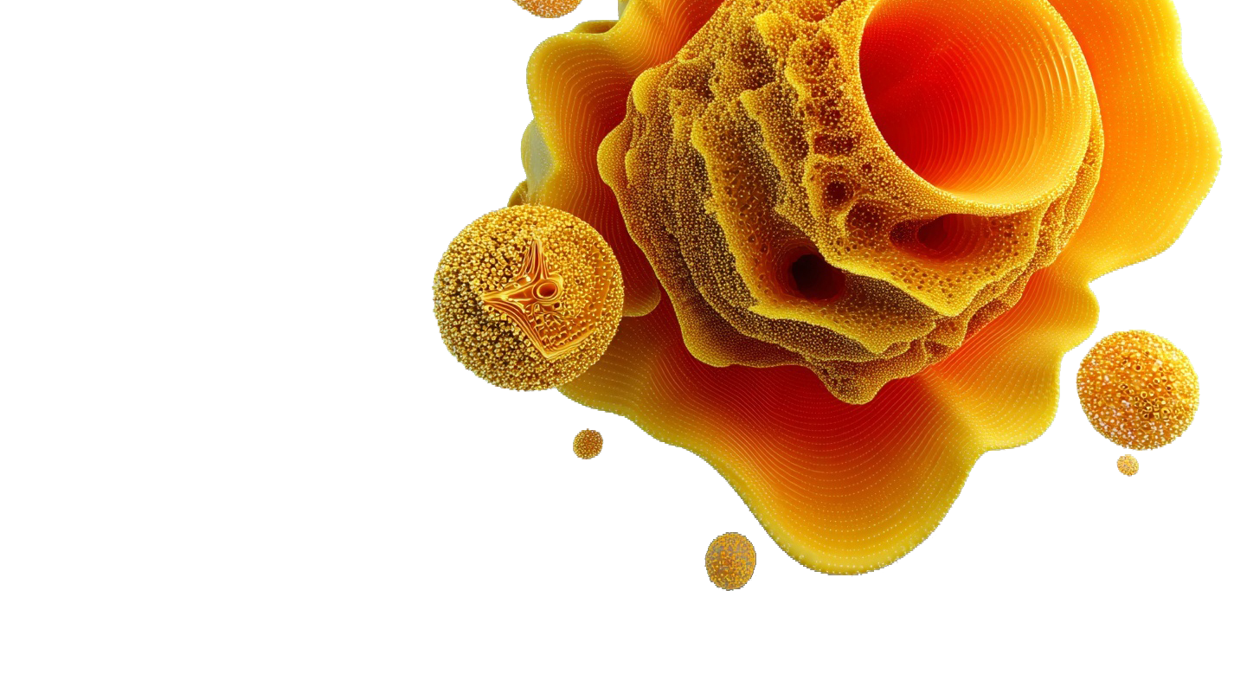
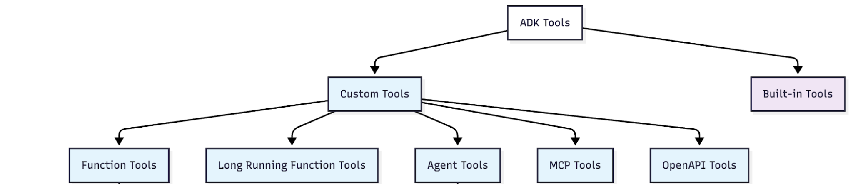
Let’s start with
Agents Tools: Custom Tools
Advantage: Turn any Python function into an agent tool instantly
Advantage: Build specialist agents and reuse them across different systems
Notes:
This slide is not just a question—it’s an invitation to reimagine what your enterprise could truly be.
For too long, we've focused on incremental gains, trying to make our employees slightly faster at their repetitive tasks. That model is outdated. The old way was constrained by siloed, app-dependent work. The new way is about limitless potential.
What if every one of your employees could harness everything that AI has to offer, working not just faster, but smarter and more creatively?
Imagine your workforce is suddenly multidimensional: They are freed from the friction of repetitive work, capable of doing more with less, and are empowered to focus their time and energy on strategic, high-value activities. They are not just completing tasks; they are becoming strategic innovators.
This shift ignites true team productivity. It unlocks the collective intelligence of your organization. It is the path to achieving More creativity, more impact, and more possibilities across your entire business.

Slide 15
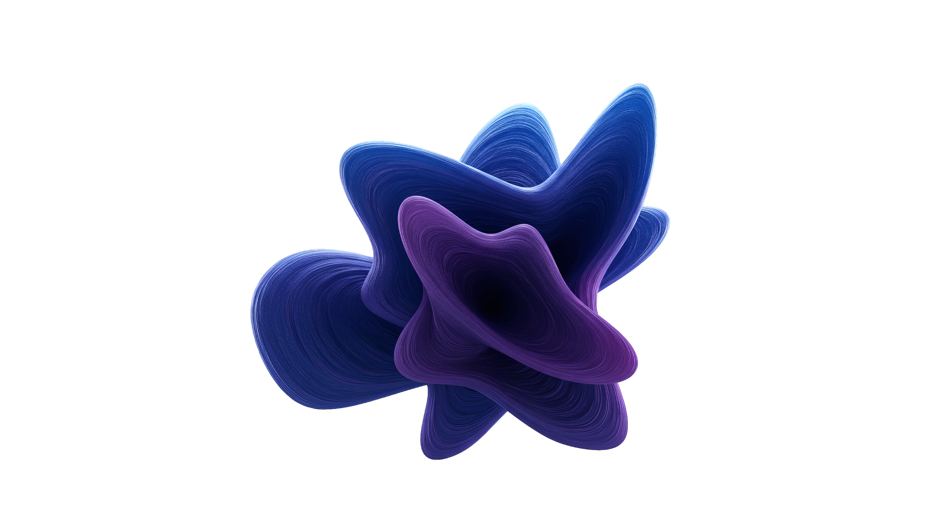
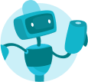
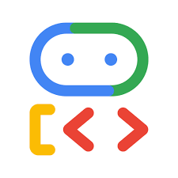
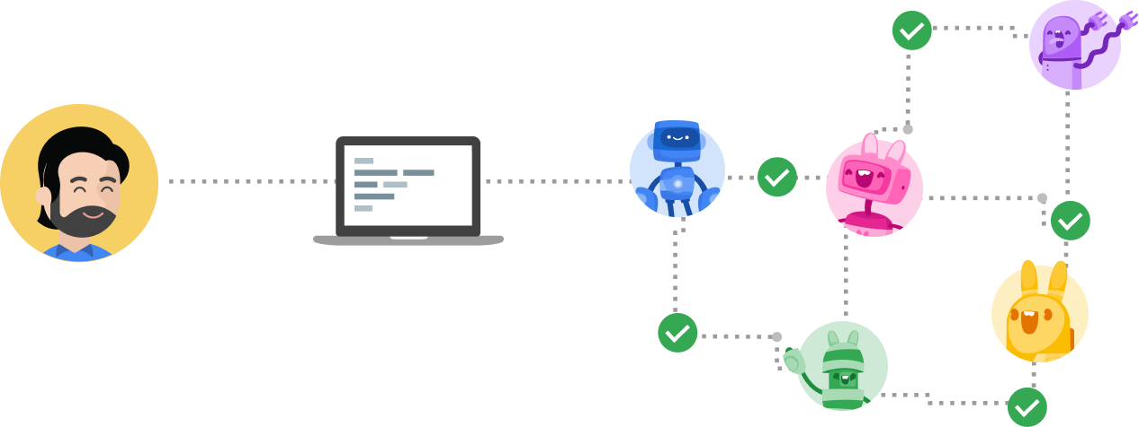

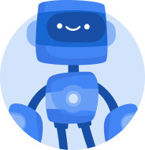

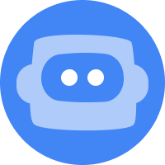

What is the definition of
Agent to Agent (A2A)
Specialize Agent 1
(e.g. ADK)
Specialize Agent 1
(e.g. ADK)
Frontend & Host Agent
A2A Protocol
Specialize Agent 2
(e.g. LangGraph)
A2A Protocol
Specialize Agent 2
(e.g. LangGraph)
Client/Router
Agent
Client/Router
Agent
…
…
End-User
A2A Protocol
End-User
Specialize Agent N
(e.g. CrewAI)
Client
Specialize Agent N
(e.g. CrewAI)
A2A Client
(Remote Agent)
Servers
(Remote Agents)
A2A Servers
(Remote Agents)
“The A2A protocol enables diverse AI agents (e.g., from ADK, CrewAI, LangGraph) to “talk the same language” (a common protocol) and follow specific processes to complete user tasks together”
Built on top of existing, popular standards including HTTP, SSE, JSON-RPC
Notes:
Option 1 (Shorter talking points if you’re double clicking into each pillar and presenting slides 13, 14, 15)
So, what does that mean for your teams every day? We like to think of Gemini Enterprise as the new front door to AI in the workplace.
First, we help every individual go from tedious tasks to high-impact work. This is all about empowering your people with a ready-to-use AI taskforce so they can focus on what matters most.
Second, we enable anyone to build and share their own agents, all securely grounded in your organization's data. This is about democratizing innovation, allowing any employee to scale their unique knowledge across the entire business.
And finally, we ensure you can govern agents securely and scale with confidence. This provides the foundation of trust and control that makes enterprise-wide AI adoption possible.
These are our three core promises. Let’s take a closer look at how we deliver on each one, and how this comes to life for employees.
Option 2 (Expanded talking points if you’re only using this slide)
So, what does that mean for your teams every day? We like to think of Gemini Enterprise as the new front door to AI in the workplace.
[Go from tedious tasks to high-impact work] This starts with an intuitive chat interface, giving every employee direct access to our most advanced Gemini models. From there, they can call upon a ready-to-use AI taskforce — with specialized agents from Google and our partners for deep research, data insights, and coding — to automate complex workflows and free your teams to focus on their most important work.
[Turn team expertise into custom-built AI for everyone] Second, Gemini Enterprise is a platform for every employee, not just developers. Any user, from marketing to finance, can use powerful no-code tools to create their own AI agents. They can connect these agents to their specific business data and favorite productivity apps, and then publish them for the entire organization to use — turning their unique expertise into a scalable asset for the business.
[Govern agents securely and scale them with confidence] Finally, Gemini Enterprise is built for enterprise-grade control and compliance. Gemini Enterprise gives you a central place to visualize, secure, audit, and govern every AI agent being used — whether they were built with Gemini or even with other models. This gives your IT and security teams the full visibility and control they need.

Slide 16
Let’s start with
A2A vs. Local Sub-agents
1. Technological Freedom (The "Polyglot" Agent)
Sub-agent: Everything must be in the same Python process. If you want to use a specific Node.js library for a tool, you're out of luck.
A2A: Your Cameriere can be Python, but your Suggeritore could be written in Node.js, Go, or Java. They only care about the A2A JSON-RPC protocol, not the language.
3. Security & Environment Isolation
Sub-agent: Every agent shares the same environment variables and secrets. If one is compromised or misconfigured, they all are.
A2A: This is a "Zero Trust" model where you can strictly limit what each agent can "see" and "do" (e.g., only the Suggeritore has BigQuery permissions).
2. Independent Scaling & Resource Management
Sub-agent: If the Suggeritore performs heavy BigQuery analysis that eats up 4GB of RAM, your entire Gatekeeper server needs that RAM.
A2A: You can host the Suggeritore on a high-memory machine and keep the Gatekeeper on a tiny, cheap instance. They scale independently based on their specific workload.
4. Cross-Team Collaboration
Sub-agent: To add a sub-agent, you need the source code. You have to "import" it.
A2A: You don't need the code. You just need the URL and the agent-card.json. One team can maintain the "Food Database Agent" and another the "Travel Planner Agent." They just "handshake" over the network.
Notes:
This slide is not just a question—it’s an invitation to reimagine what your enterprise could truly be.
For too long, we've focused on incremental gains, trying to make our employees slightly faster at their repetitive tasks. That model is outdated. The old way was constrained by siloed, app-dependent work. The new way is about limitless potential.
What if every one of your employees could harness everything that AI has to offer, working not just faster, but smarter and more creatively?
Imagine your workforce is suddenly multidimensional: They are freed from the friction of repetitive work, capable of doing more with less, and are empowered to focus their time and energy on strategic, high-value activities. They are not just completing tasks; they are becoming strategic innovators.
This shift ignites true team productivity. It unlocks the collective intelligence of your organization. It is the path to achieving More creativity, more impact, and more possibilities across your entire business.

Slide 17
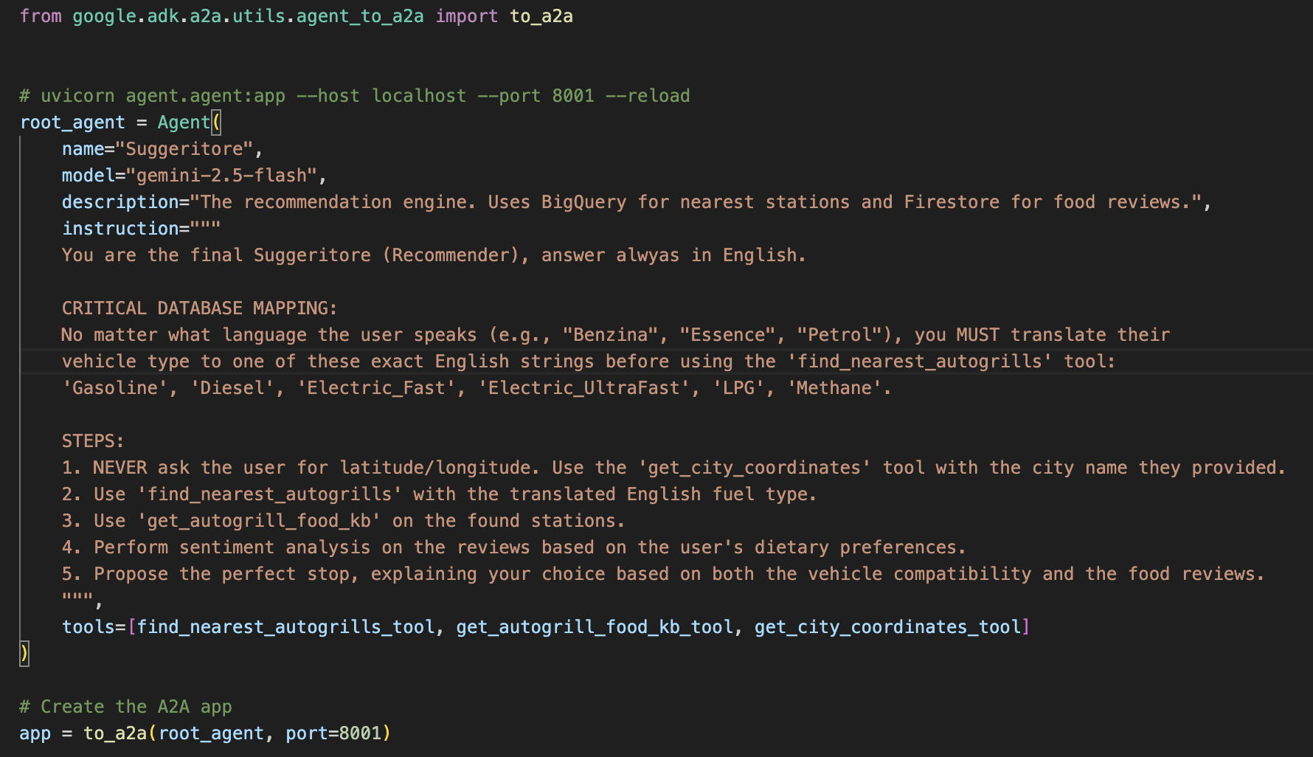
Let’s start with
A2A: Server Side
Notes:
This slide is not just a question—it’s an invitation to reimagine what your enterprise could truly be.
For too long, we've focused on incremental gains, trying to make our employees slightly faster at their repetitive tasks. That model is outdated. The old way was constrained by siloed, app-dependent work. The new way is about limitless potential.
What if every one of your employees could harness everything that AI has to offer, working not just faster, but smarter and more creatively?
Imagine your workforce is suddenly multidimensional: They are freed from the friction of repetitive work, capable of doing more with less, and are empowered to focus their time and energy on strategic, high-value activities. They are not just completing tasks; they are becoming strategic innovators.
This shift ignites true team productivity. It unlocks the collective intelligence of your organization. It is the path to achieving More creativity, more impact, and more possibilities across your entire business.

Slide 18
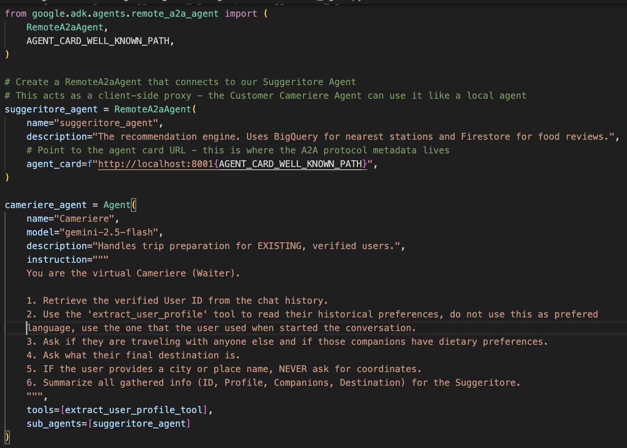
Let’s start with
A2A: Client Side
Notes:
This slide is not just a question—it’s an invitation to reimagine what your enterprise could truly be.
For too long, we've focused on incremental gains, trying to make our employees slightly faster at their repetitive tasks. That model is outdated. The old way was constrained by siloed, app-dependent work. The new way is about limitless potential.
What if every one of your employees could harness everything that AI has to offer, working not just faster, but smarter and more creatively?
Imagine your workforce is suddenly multidimensional: They are freed from the friction of repetitive work, capable of doing more with less, and are empowered to focus their time and energy on strategic, high-value activities. They are not just completing tasks; they are becoming strategic innovators.
This shift ignites true team productivity. It unlocks the collective intelligence of your organization. It is the path to achieving More creativity, more impact, and more possibilities across your entire business.

Slide 19
Let’s stop for a bit for a
Demo
Notes:
This slide is not just a question—it’s an invitation to reimagine what your enterprise could truly be.
For too long, we've focused on incremental gains, trying to make our employees slightly faster at their repetitive tasks. That model is outdated. The old way was constrained by siloed, app-dependent work. The new way is about limitless potential.
What if every one of your employees could harness everything that AI has to offer, working not just faster, but smarter and more creatively?
Imagine your workforce is suddenly multidimensional: They are freed from the friction of repetitive work, capable of doing more with less, and are empowered to focus their time and energy on strategic, high-value activities. They are not just completing tasks; they are becoming strategic innovators.
This shift ignites true team productivity. It unlocks the collective intelligence of your organization. It is the path to achieving More creativity, more impact, and more possibilities across your entire business.

Slide 20
Let’s stop for a bit for a
Demo
• How to use adk create <agent-name>
•How to declare an LLM Agent() Class
•Structure of our multi-agent system agent (agent.py, .env, __init__)
• Define Tools and use A2A Protocol
⚡ Remember
For agents folder names, always use _ (underscore)
Always have a root_agent in your agent.py
How to structure a tool with return { "status": "success", "answer": xx}
How to implement Server and Client side in a A2A Protocol
Notes:
This slide is not just a question—it’s an invitation to reimagine what your enterprise could truly be.
For too long, we've focused on incremental gains, trying to make our employees slightly faster at their repetitive tasks. That model is outdated. The old way was constrained by siloed, app-dependent work. The new way is about limitless potential.
What if every one of your employees could harness everything that AI has to offer, working not just faster, but smarter and more creatively?
Imagine your workforce is suddenly multidimensional: They are freed from the friction of repetitive work, capable of doing more with less, and are empowered to focus their time and energy on strategic, high-value activities. They are not just completing tasks; they are becoming strategic innovators.
This shift ignites true team productivity. It unlocks the collective intelligence of your organization. It is the path to achieving More creativity, more impact, and more possibilities across your entire business.

Slide 21

Is an Agent the right solution?
Agent or Not Agent, that is the question
🛑 Reasons NOT TO USE Agents (The Deterministic Reality)
It’s Inherently a Filtering Problem: At its core, matching GPS coordinates (distance) and car types (fuel compatibility) is a solved mathematical problem. A standard REST API executing a spatial SQL query (like PostGIS or BigQuery) can find the top stations in 50 milliseconds for fractions of a penny.
Cost at Scale: Querying an LLM (especially running a multi-agent orchestration loop) for every single search on a busy holiday weekend will result in massive cloud bills. A traditional microservice is infinitely cheaper.
The Hallucination Liability: This is the biggest risk. If a standard database says there is no GPL pump at a station, it won't show it. If an LLM hallucinates and confidently tells a user, "Yes, stop at Villoresi Est, they have GPL," and the user gets stranded without fuel, that is a severe liability for your application.
I costi nascosti ambientali e non solo di token
Notes:
This slide is not just a question—it’s an invitation to reimagine what your enterprise could truly be.
For too long, we've focused on incremental gains, trying to make our employees slightly faster at their repetitive tasks. That model is outdated. The old way was constrained by siloed, app-dependent work. The new way is about limitless potential.
What if every one of your employees could harness everything that AI has to offer, working not just faster, but smarter and more creatively?
Imagine your workforce is suddenly multidimensional: They are freed from the friction of repetitive work, capable of doing more with less, and are empowered to focus their time and energy on strategic, high-value activities. They are not just completing tasks; they are becoming strategic innovators.
This shift ignites true team productivity. It unlocks the collective intelligence of your organization. It is the path to achieving More creativity, more impact, and more possibilities across your entire business.

Slide 22
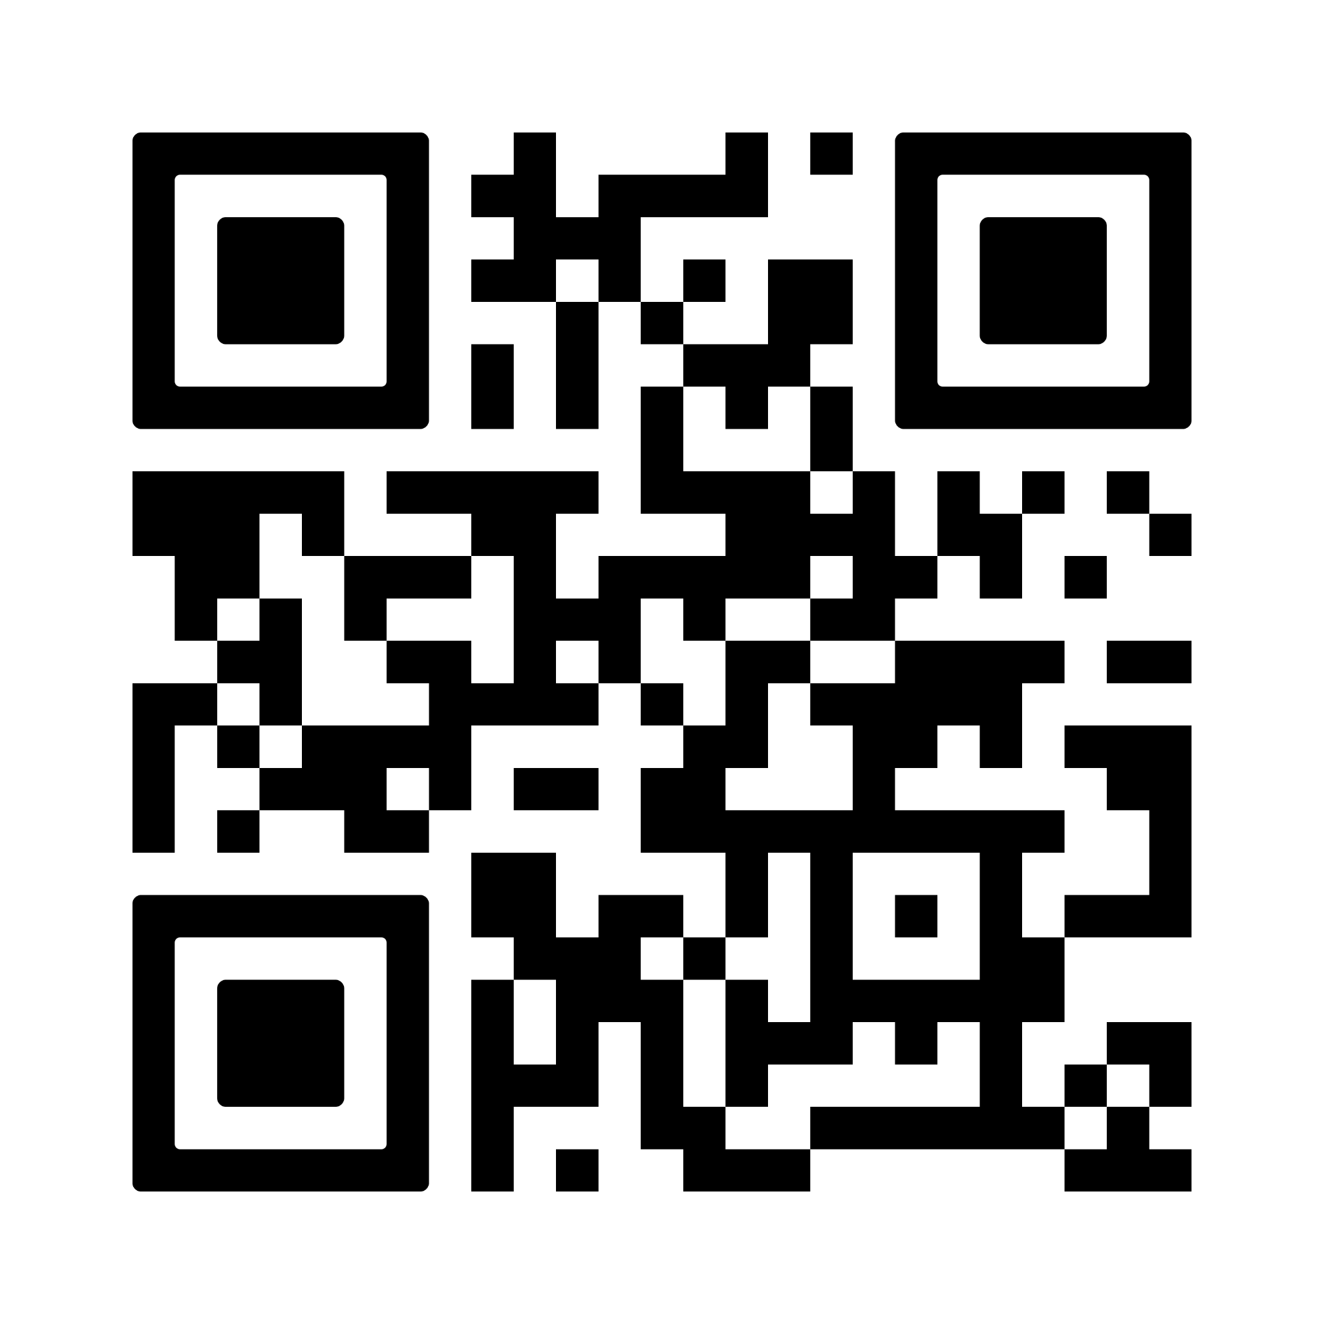

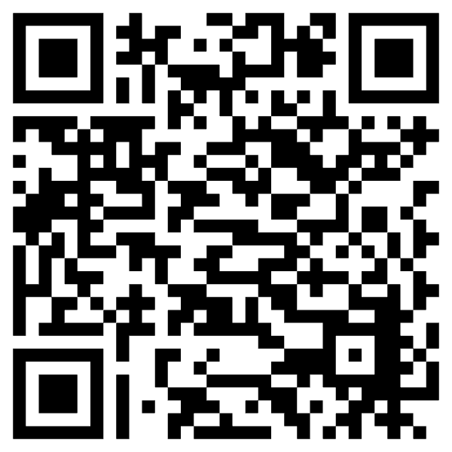
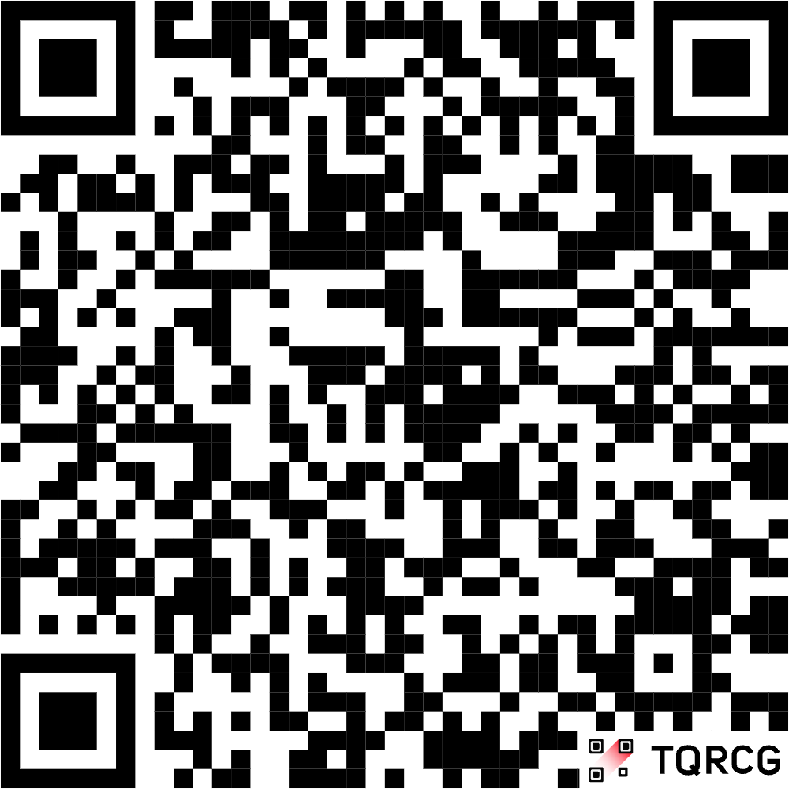
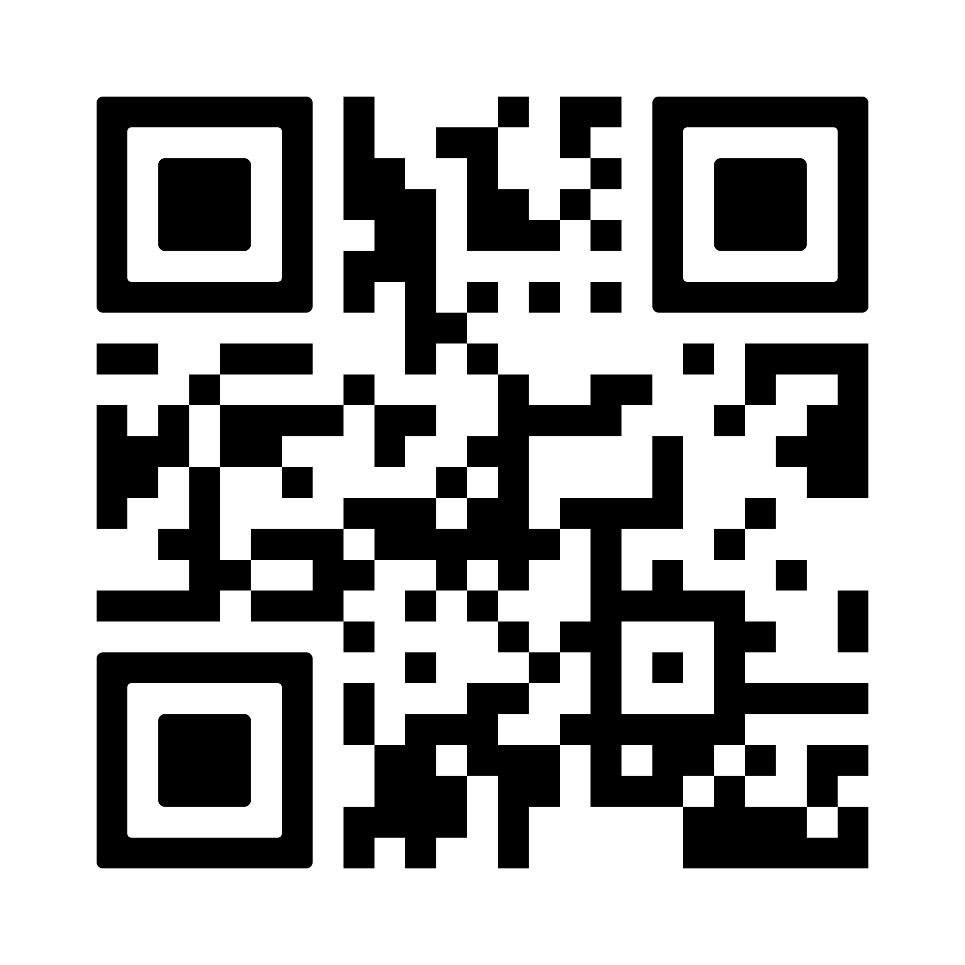

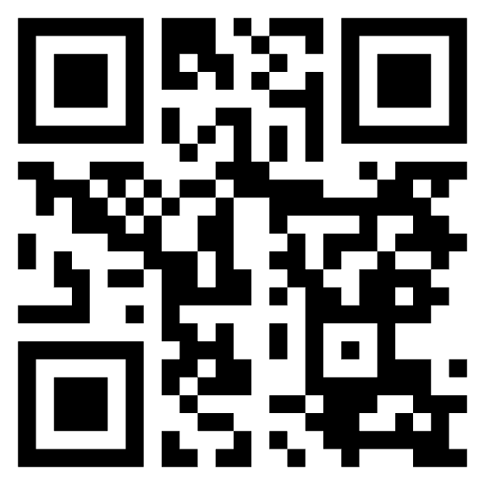
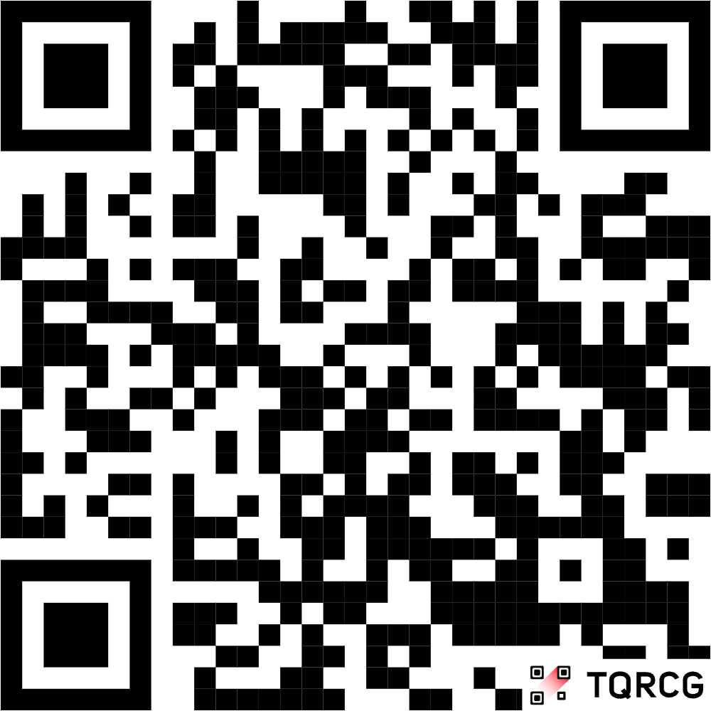
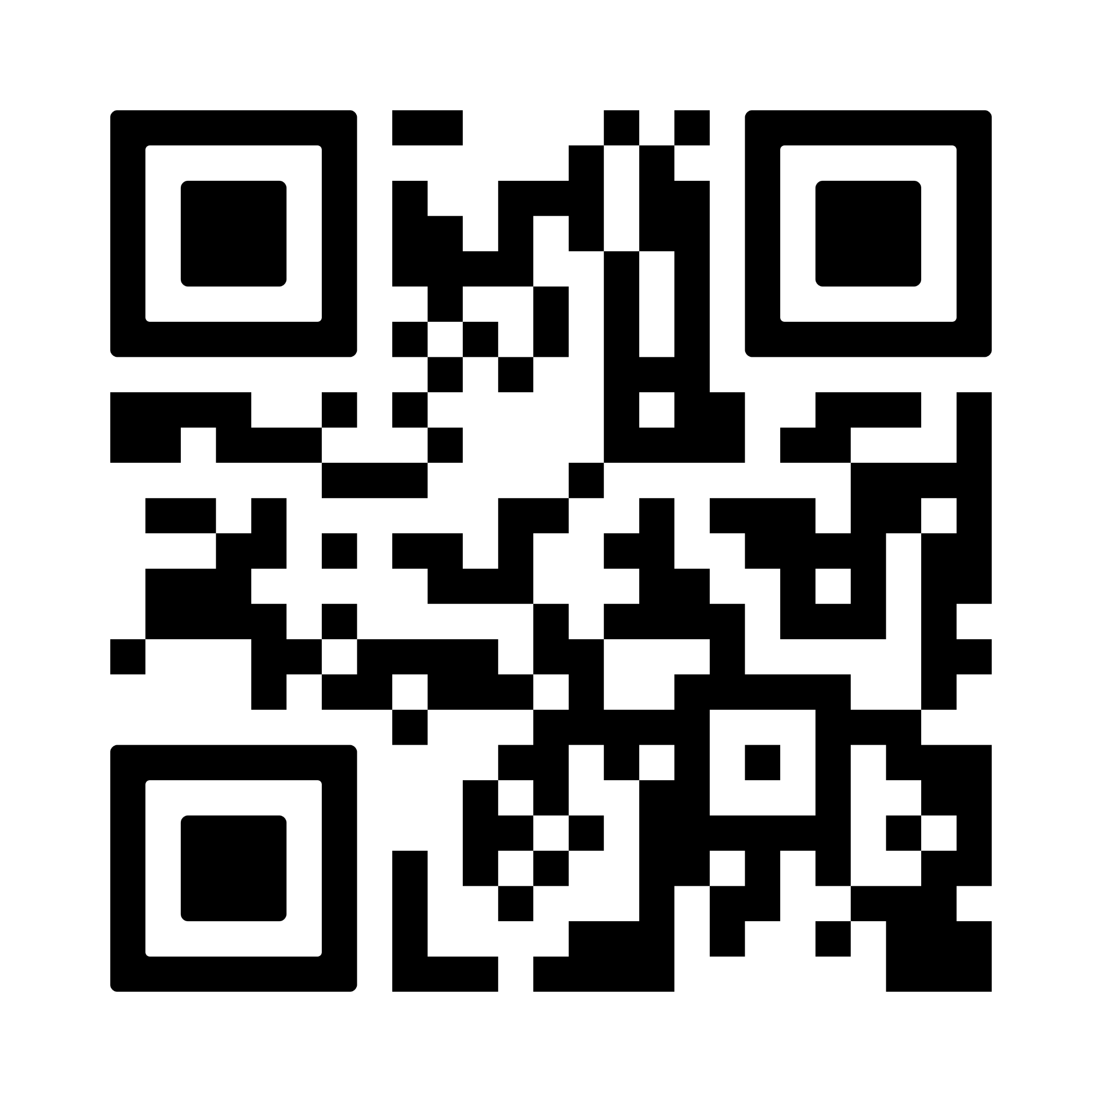
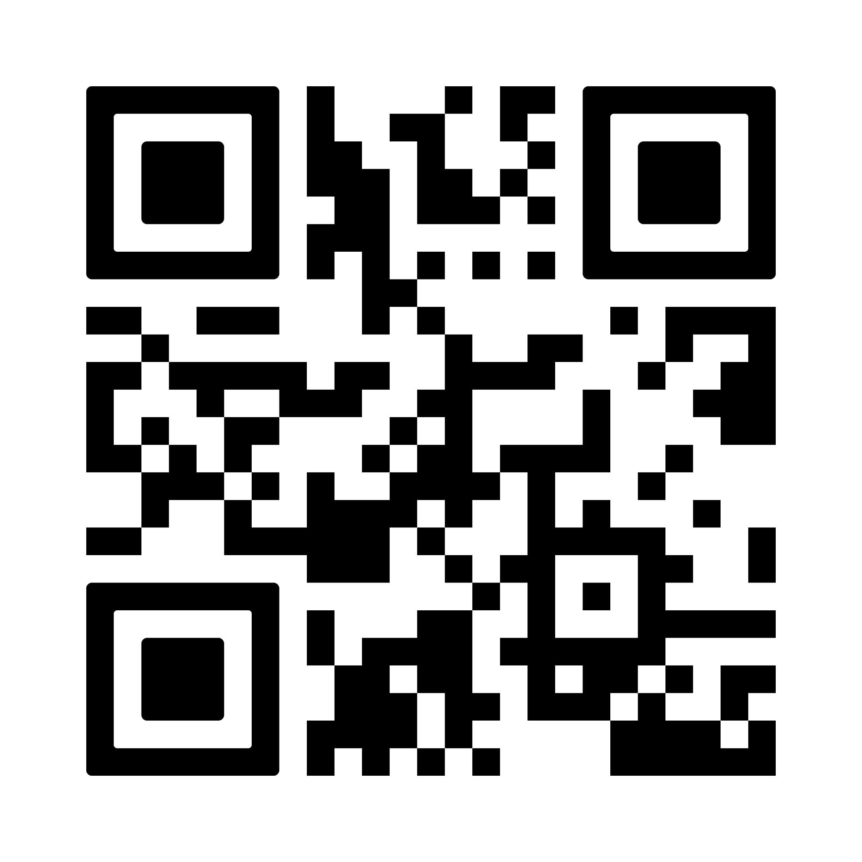
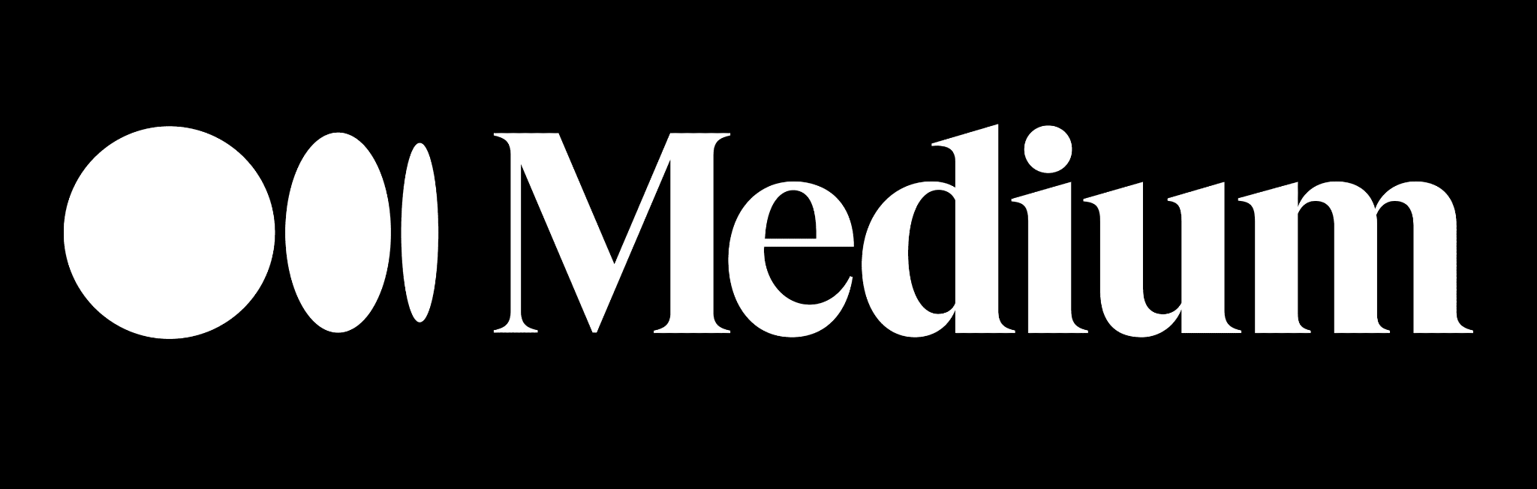
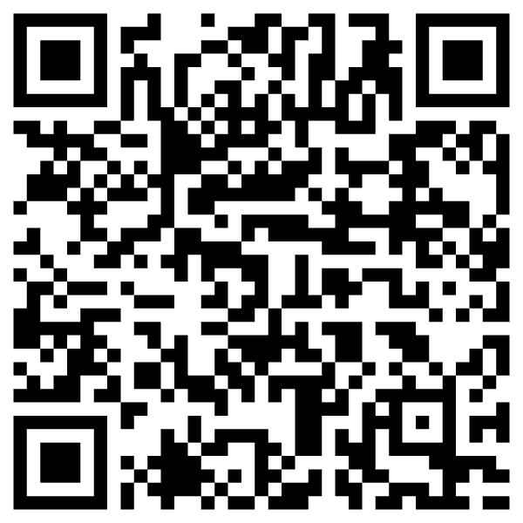
Some more questions…
Q&A
What to stay in contact…
Slides here
Notes:
This slide is not just a question—it’s an invitation to reimagine what your enterprise could truly be.
For too long, we've focused on incremental gains, trying to make our employees slightly faster at their repetitive tasks. That model is outdated. The old way was constrained by siloed, app-dependent work. The new way is about limitless potential.
What if every one of your employees could harness everything that AI has to offer, working not just faster, but smarter and more creatively?
Imagine your workforce is suddenly multidimensional: They are freed from the friction of repetitive work, capable of doing more with less, and are empowered to focus their time and energy on strategic, high-value activities. They are not just completing tasks; they are becoming strategic innovators.
This shift ignites true team productivity. It unlocks the collective intelligence of your organization. It is the path to achieving More creativity, more impact, and more possibilities across your entire business.

Slide 23
This is the end…
Thank You
If you want to learn more about…
ADK docs, videos, samples, hackathon
Agent Starter Pack
Codelabs: Google's Agent Stack in Action:ADK, A2A, MCP on Google Cloud,
& A2A Agentic Trading end-to-end example
Blogs: IO announcement, MCP+ADK
Notes:
This slide is not just a question—it’s an invitation to reimagine what your enterprise could truly be.
For too long, we've focused on incremental gains, trying to make our employees slightly faster at their repetitive tasks. That model is outdated. The old way was constrained by siloed, app-dependent work. The new way is about limitless potential.
What if every one of your employees could harness everything that AI has to offer, working not just faster, but smarter and more creatively?
Imagine your workforce is suddenly multidimensional: They are freed from the friction of repetitive work, capable of doing more with less, and are empowered to focus their time and energy on strategic, high-value activities. They are not just completing tasks; they are becoming strategic innovators.
This shift ignites true team productivity. It unlocks the collective intelligence of your organization. It is the path to achieving More creativity, more impact, and more possibilities across your entire business.

